Slide 1
VE203 Recitation Class
2019.10.9
Chenyu Zhu

Slide 2
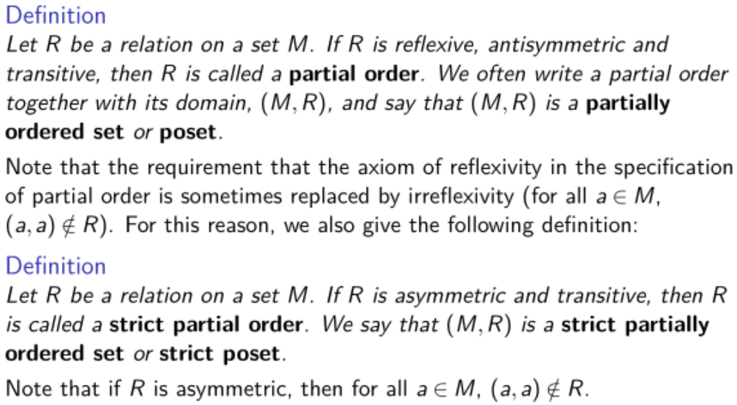
Orders

Slide 3
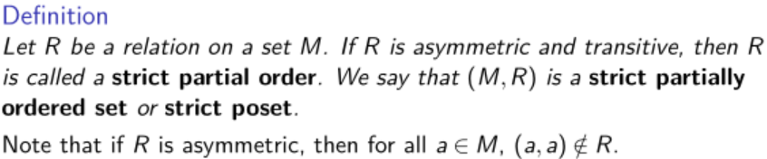
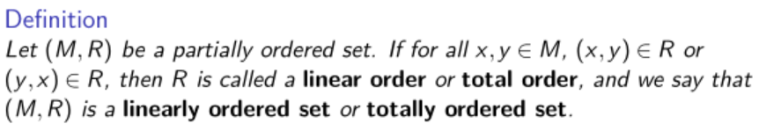
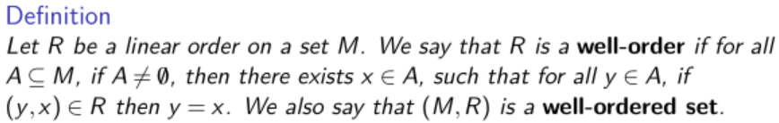
Orders

Slide 4
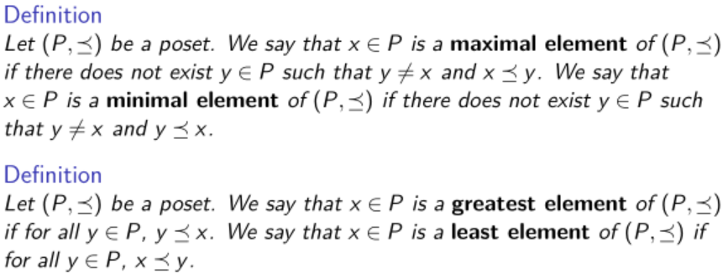
Orders
What are the differences?

Slide 5
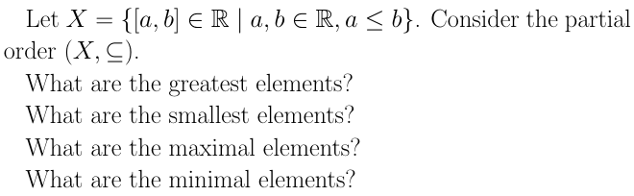
Orders-Exercise

Slide 6
Orders-Exercise
No greatest/smallest/maximal elements.
Minimal elements are something like {0}, {1}, {2}, etc.

Slide 7
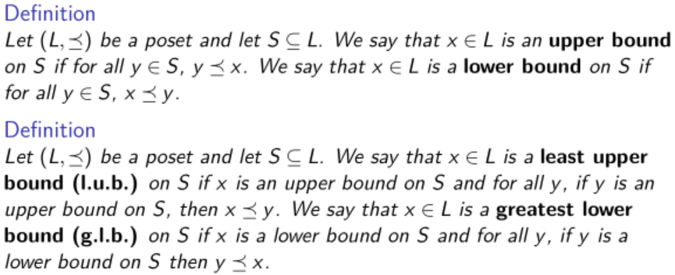
Lattice

Slide 8

Lattice
These are very useful conclusions:

Slide 9
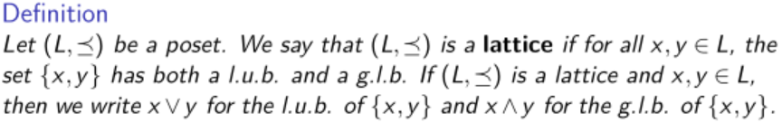
Lattice

Slide 10
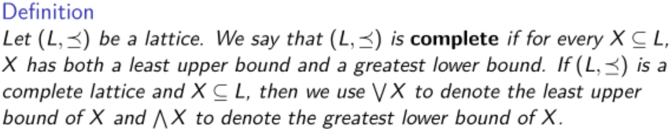
Lattice
Conclusion: Every non-empty finite lattice is a complete lattice.

Slide 11
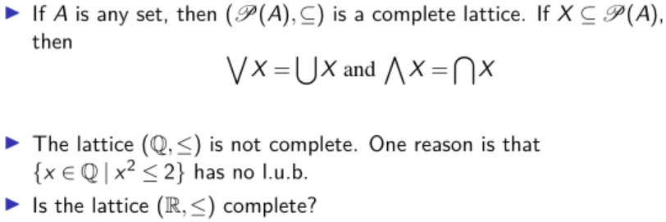
Lattice
The lattice (R,≤) is not complete.

Slide 12
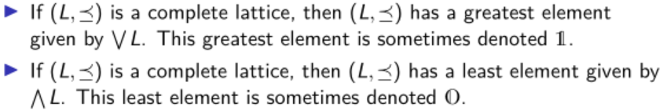
Lattice

Slide 13

Lattice

Slide 14
Lattice
It's a lattice, but it is not complete.
N'={x|There exists m∈N* such that x=2^{m}}

Slide 15
Lattice

Slide 16
Lattice
It's a complete lattice. Although A can be an infinite set, if A is properly defined then we can say A is the least upper bound of the lattice.

Slide 17
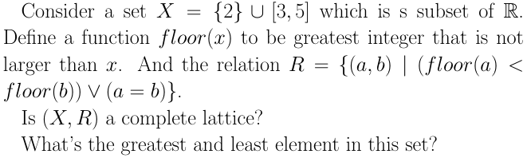
Lattice

Slide 18
Lattice
This is in fact an infinite complete lattice.
The greatest element is 5 and least element is 2.
How to understand the concept of “infinite”?

Slide 19
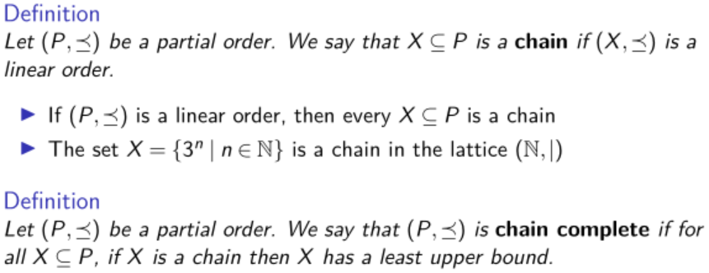
Chain Complete Posets
Attention: This definition ensures the existence of a unique least element.

Slide 20
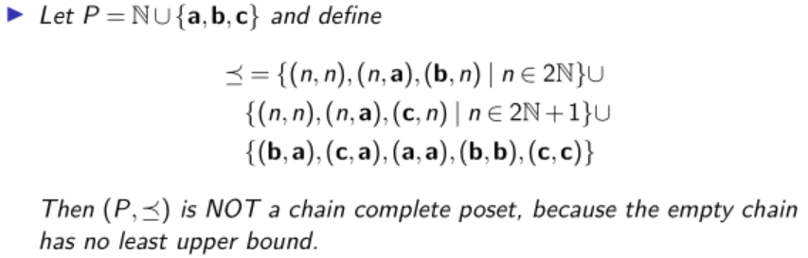
Chain Complete Posets

Slide 21

Chain Complete Posets
It is a complete lattice. It is also a chain-complete poset.

Slide 22
A brief summary
The definition of order, linear order, well-order
The definition of upper/lower bounds, lattice, complete lattice
The definition of chain and chain-complete poset

Slide 23
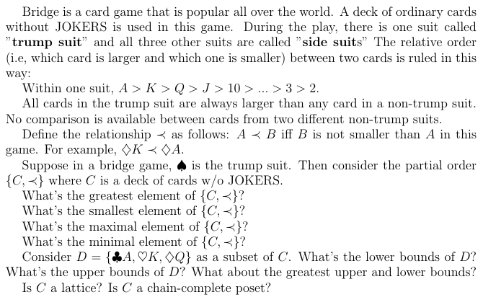
Fun Quiz

Slide 24
Fun Quiz-Solution
Greatest element: ♠A
Maximal element: ♠A
Least element does not exist.
Minimum element: ♦2, ♥2, ♣2
Lower bounds of D does not exist.
Upper bounds of D is all spades. Least upper bound of D is ♠2.
It is not a lattice, and it is not a chain-complete poset.

Slide 25
A brief summary
partial order
lattice
unique
minimal
/maximal
element?
infinite?
linear order = chain
well-order

Slide 26
A brief summary
partial order
lattice
complete lattice
unique minimal/maximal element?
infinite?
complete lattice
chain-complete poset
chain-complete poset

Slide 27
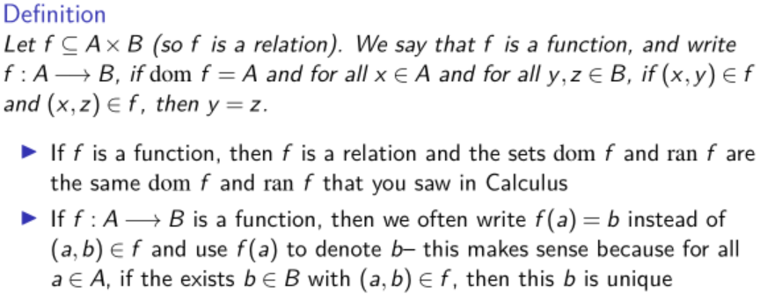
Functions

Slide 28
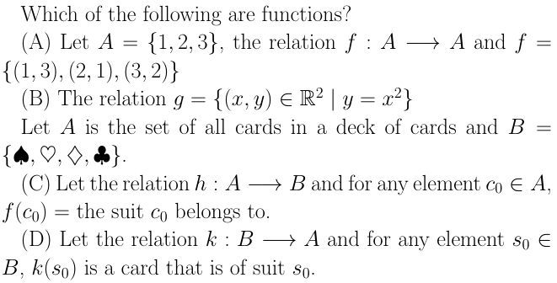
Functions
A, B, C

Slide 29
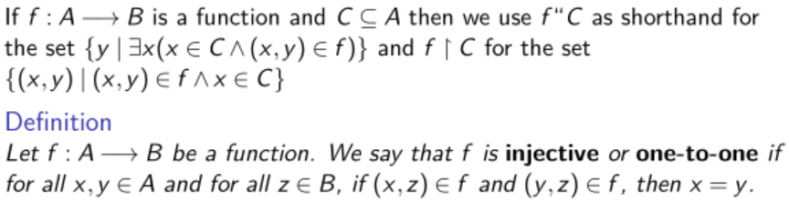
Functions

Slide 30
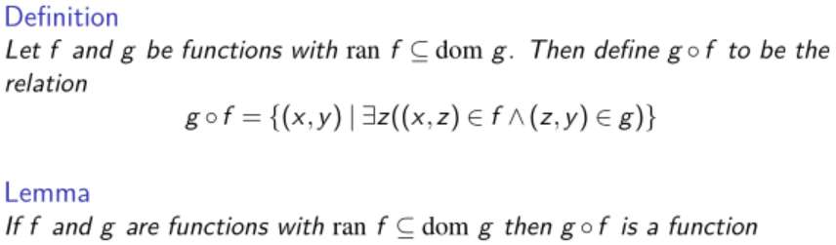
Functions

Slide 31
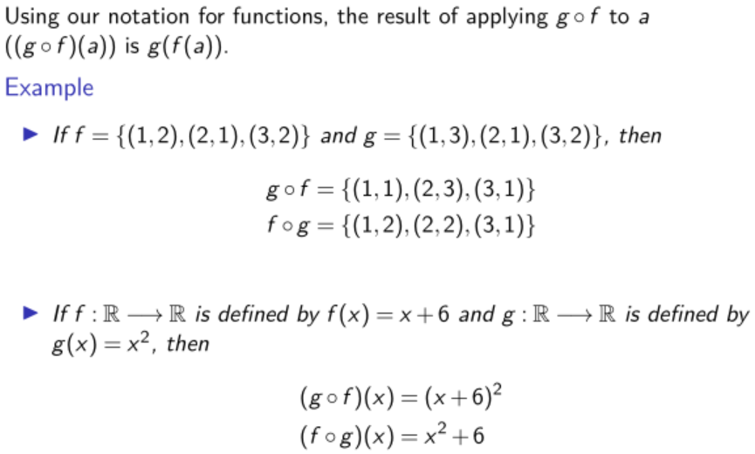
Functions

Slide 32
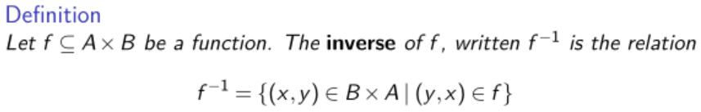
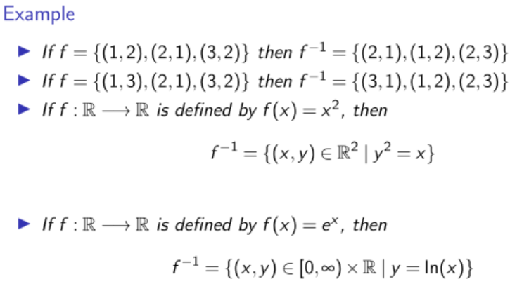
Functions

Slide 33
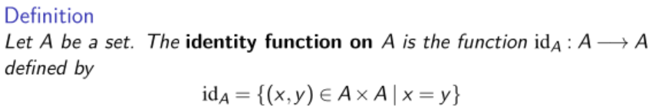
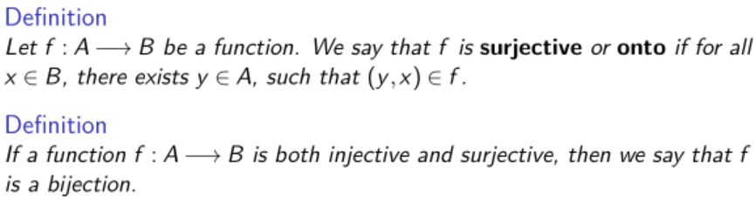
Functions

Slide 34

Functions-Fun Quiz

Slide 35
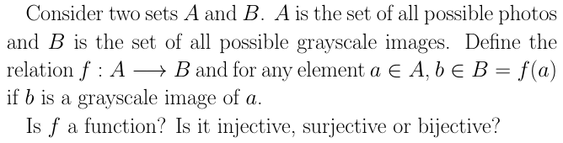
Functions-Fun Quiz

Slide 36
Functions-Fun Quiz
It's a surjective function.
That's why rgb2gray(img) is available while gray2rgb(img) is unavailable.

